Slide 1
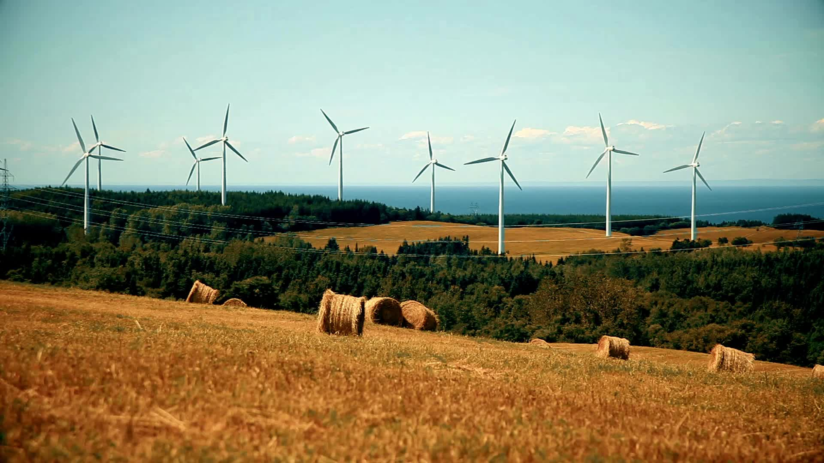
Energy/Renewable Industry Outlook 2025 (Individual Exploratory Purpose To Gain Insights on Energy Industry) Created by Vivekanand

Slide 2
Goal/Vision
Assess
Assess the global energy transition trends, focusing on decarbonization, electrification, and energy storage innovations.
Track
Track capital flows, government incentives, and private investment shaping market competitiveness and scalability.
Evaluate
Evaluate leading renewable and hybrid energy players on project pipelines, capex trends, and technology adoption (solar, wind, hydrogen, etc.).
Deliver
Deliver insights on risk factors and growth opportunities, including grid modernization, interconnection delays, and emerging markets expansion.
Analyze
Analyze regulatory and geopolitical drivers, including ESG mandates, carbon pricing, and energy security policies.

Slide 3
List of top 20 Renewable Energy company ticker symbols
'XOM', # ExxonMobil
'GEV', #GE Vernova, previously GE Power
'CVX', # Chevron
'NEE', # NextEra Energy
'DUK', # Duke Energy
'SO', # Southern Company
'ENB', # Enbridge
'BP', # BP Plc
'TTE', # TotalEnergies
'EQNR', # Equinor
'ORSTED.CO', # Orsted A/S
'VWS.CO', # Vestas Wind Systems
'ED', # Consolidated Edison
'D', # Dominion Energy
'PCG', # Pacific Gas & Electric
'PEG', # Public Service Enterprise Group
'BEP', # Brookfield Renewable Partners
'BE', # Bloom Energy
'FSLR', # First Solar
'RUN', # Sunrun Inc
'NRG'

Slide 4
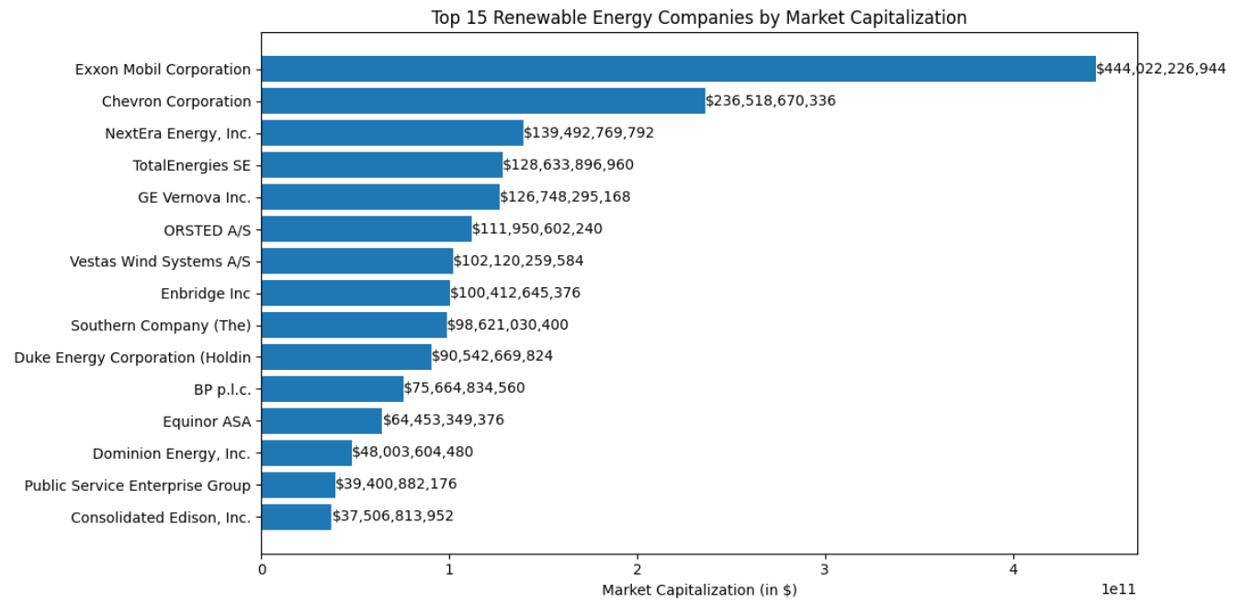
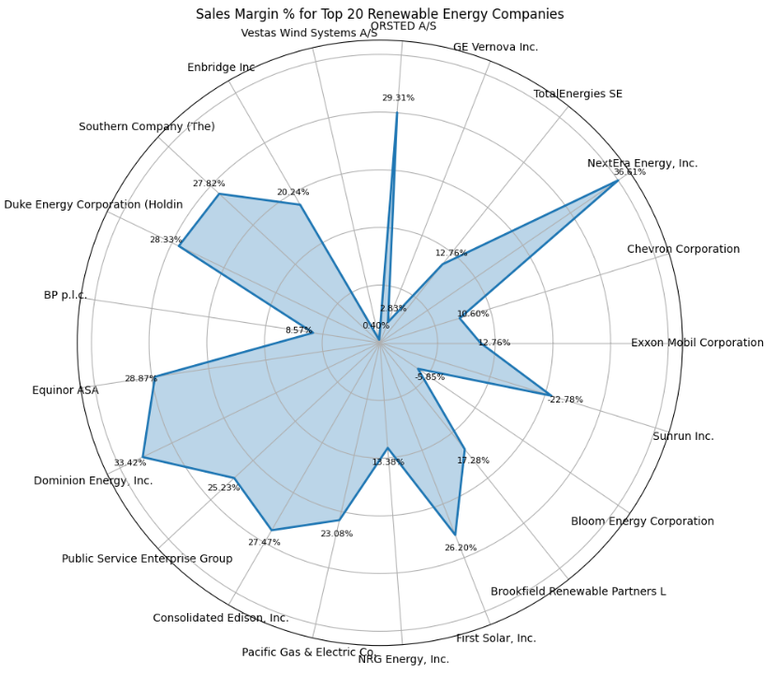
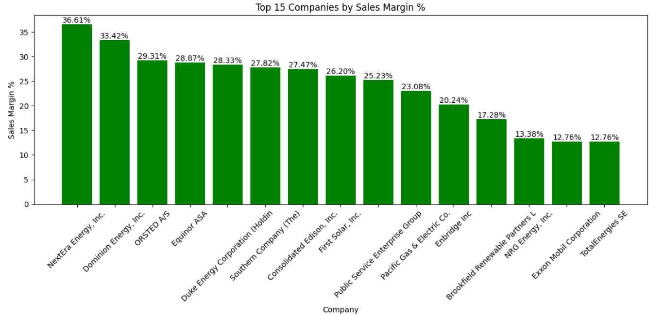
Market Cap Distribution
Sales Margin
Last Refresh: May 2025

Slide 5
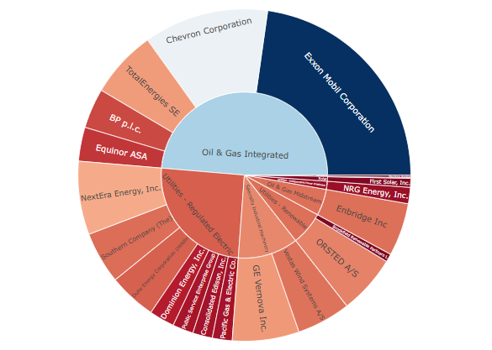
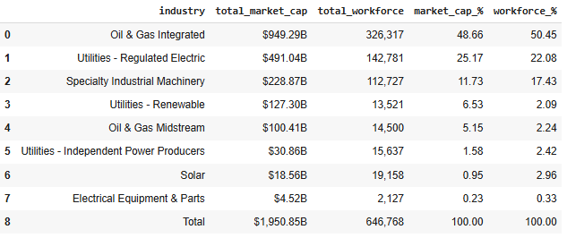
Market Cap Distribution
Last Refresh: May 2025

Slide 6
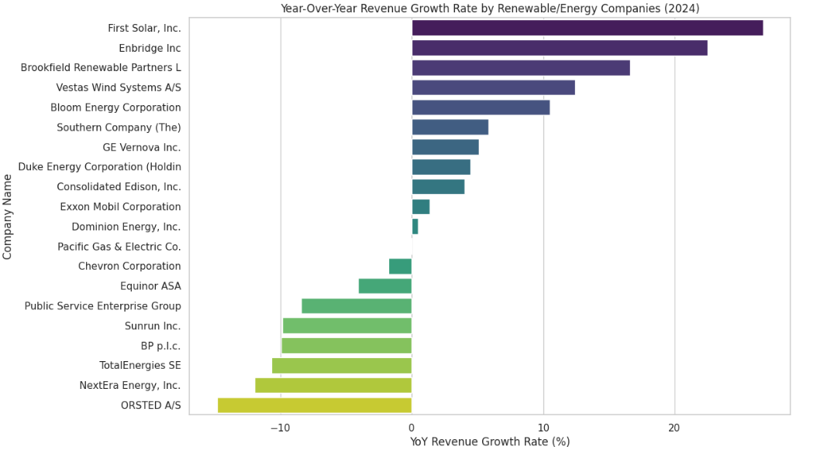
YoY Growth Rate FY 2024
Last Refresh: May 2025, Indented for Exploratory Purpose, For more Information Please refer the respective companies annual report.

Slide 7
Key Takeaways: Renewable/Energy Sector Outlook (2025)
Strong Revenue Growth Leaders: First Solar (+23% YoY) and Enbridge (+20% YoY) lead the sector in revenue growth, indicating robust performance in solar and midstream infrastructure respectively. These are likely driven by expanding renewable capacity and favorable policy tailwinds.
Underperformance in Major Utilities: Traditional power utilities like NextEra, Orsted, and TotalEnergies show negative YoY revenue growth, reflecting challenges in grid integration, regulatory delays, or commodity volatility impacting renewables profitability.
Industry Concentration in Value and Workforce:
Oil & Gas Integrated (e.g., Exxon, Chevron) accounts for 48.66% of total market cap and over 50% of total workforce, reaffirming its dominance in capital and labor intensity despite ESG pressure.
Utilities – Regulated Electric follows with 25.17% market share, crucial for energy delivery but less agile in revenue growth.
Solar and Renewables Are High-Growth, Low-Scale: Despite strong YoY growth in firms like First Solar, the Solar industry contributes only 0.95% to market cap and 2.96% to workforce, signaling under-penetration and future upside for scale and investment.
Strategic Implication: Energy investors should balance between growth-focused clean tech (solar, fuel cells, renewables) and cash-generating traditional giants, while watching for regulatory shifts that can unlock grid modernization and distributed energy scaling.
Reference Sources: 1. yfinance API’s and 2. LLM for content refinement.
Disclaimer: This analysis is intended for individual exploratory purposes to gain insights into the energy sector. For comprehensive and official information, please refer to the respective companies' annual reports. The selection of companies reflects the author's research focus and interests. Thanks for Reading.

